Slide 1
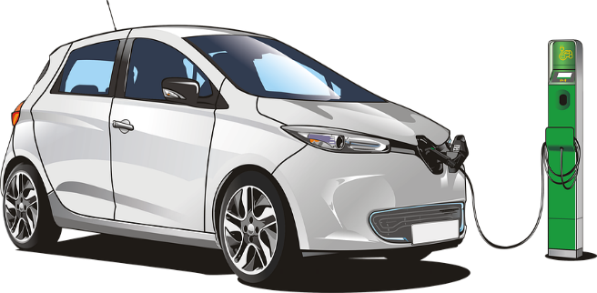
STEELS FOR ELECTRICAL MOBILITY ENGINES AND OTHER APPLICATIONS AT FREQUENCIES UNTIL 1,5kHz
DANIEL LUIZ RODRIGUES JUNIOR; FERNANDO JOSÉ GOMES LANDGRAF; ADRIANO ALEX DE ALMEIDA; THOMAS SEIJI PASCOTO NISHIKAWA
INTRODUCTION
One of the challenges of electric mobility is to increase the autonomy of vehicles. In addition to improving the batteries, it is necessary to reduce the energy consumption of the electric motors of vehicular traction. These motors must work at variable speed and have a higher power density, in other words, they have to be smaller, to save weight. The solution to these two demands, variable speed and higher power density, requires increasing the frequency of electromagnetic excitation. This technology demonstrates the creation of a new steel, which dissipates less energy when excited at frequencies above 400Hz, manufactured from a modification of the traditional process of producing non-oriented steels (also called NGO steels). The technical effect of the modification is to make the magnetic power loss less sensitive to frequency increase compared to that observed in current commercial steels.
Energy dissipation in magnetic hysteresis increases with increasing frequency of excitation. Commercially available steels have been optimized for application at 50/60Hz, and are not suitable for applications at higher frequencies. The patent adopts a low-cost solution which differs from common sense of steelmakers for electromagnetic applications: at high frequencies, it is advantageous to use steel with a small degree of work-hardening, provided that within certain limits.
APPLICATION AND TARGET MARKET
The technology fits into the engineering field, more precisely in the metallurgical engineering sector and has its application in the electrical engineering sector.
Figures 1. Electric car.
2. Graph of performance differences between the commercial steel and this technology, revealing that at high frequencies the power loss is lower in the steel of this patent.
DEVELOPMENT STAGE
area: Energy 0026/2017 Polytechnical School – USP
Patent protected under the no.: BR 102018067976-7
São Paulo Pole alelima@usp.br www.patentes.usp.br

