Slide 1
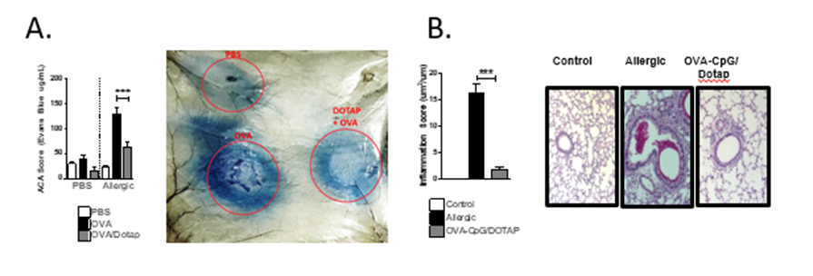
IMMUNOTHERAPY ON THE TREATMENT OF ASTHMA, RHINITIS, FOOD ALLERGY
RICARDO WESLEY ALBERCA CUSTÓDIO; MOMTCHILO RUSSO.
INTRODUCTION
Allergies’, and particularly asthma’s, prevalence is rising worldly, with a high premature mortality level on every year from a lack of adequate treatment. Allergic asthma is characterized as a chronic pulmonary inflammatory disease mediated by type 2 auxiliary T cells (Th2), which lead the pulmonary infection. The most common current asthma treatment is pharmacological, but it is not curative, and may also not be effective on all patients. On the other hand, Specific-Immunotherapy (SIT) is considered an immunological intervention with curative potential, and consists, in its classic model, on the repeated subcutaneous administration of the allergen at increasing doses for a long period of time. However, this method has its own inconveniences, such as difficulty of treatment adherence due to the many needed SIT doses for a long period; low efficacy on reverting the asthmatic condition; and mostly potential of triggering an anaphylactic shock as the allergen dose is increased, which could lead to the patient’s death.
With this concern, it has been developed an immunotherapy process for asthma, tested on an experimental model, with a formulation composed of specific(s) antigen(s) and agonist(s) of type Toll receptors (CpG-ODN) encapsulated in cationic liposome (DOTAP or N- [1- (2,3-Dioleoyloxy) propyl] -NN, N, N-trimethylammonium). Verification of this technology has shown that the treatment of previously sensitized animals with a formulation containing the antigen (allergen) and the agonist of TLR (CpG-ODN) encapsulated in cationic liposome (DOTAP) was more efficient on reversing an already stablished pulmonary allergic condition than the other tested immunotherapies. Beyond that, the local or systemic anaphylactic response was attenuated by the encapsulation of the allergen in liposome (Image A), and the treatment with three doses of the formulation on a two weeks span was sufficient to inhibit significantly the pulmonary allergy (Image B).
APPLICATION AND TARGET MARKET
This formulation may be used on the prevention, treatment or cure of allergic processes such as asthma, rhinitis, and food allergy, with reduced risk of inducing anaphylaxis, short treatment span, and more efficiency that the classic SIT.
Different results (exposed in the images above) of controlled experimentation with previously sensitized animals show that the encapsulation with DOTAP reduces cutaneous anaphylactic reaction and that the immunotherapy with OVA-CpG/DOTAP is efficient to attenuate allergic responses induced by OVA.
DEVELOPMENT STAGE
Area: Health and Care (Human and Animals); Others; 0054/2018
SUPPORT AND FOMENTATION: processes no. 2015/16728-9, 2013/24694-1 e 2016/16602-8, Fundação de Amparo à Pesquisa do Estado de São Paulo (FAPESP). “Opinions, hypotheses and conclusions or recommendations expressed in this material are the responsibility of the author (s) and not necessarily reflect the vision of FAPESP”. CNPq;
Biomedical Sciences Institute - USP
Patent protected under the no. BR102018070339-0
São Paulo Pole
alelima@usp.br www.patentes.usp.br

