Slide 1
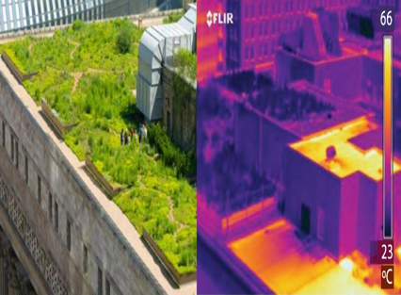
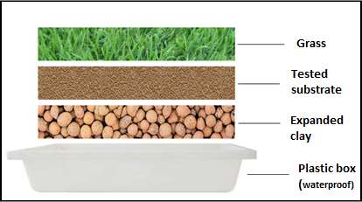
ORGANIC SUBSTRATES MADE OF SUGARCANE BAGASSE AND COCONUT FIBER FOR GREEN ROOFS.
MILLA ARAÚJO DE ALMEIDA; RENATA COLOMBO.
INTRODUCTION
Green roofs are sustainable alternatives that have been used in construction to minimize environmental impacts. It consists of installing a vegetation cover on the buildings, replacing the conventional roof. Among the indispensable item for its installation is the organic substrate, which is one of the items responsible for the high cost of these coverages implementation.
Thus, the present technology develops a cheaper and faster process that uses a simpler combination of raw materials (compared with the currently available processes) like sugarcane bagasse and green coconut fiber, for the production of these substrates for green roofs.
This invention distinguishes itself therefore by obtaining high quality substrates that presents also sustainable character due to the use of agro-industrial waste.
APPLICATION AND TARGET MARKET
The technology works as a support tool in the building industry and in the farming industry, aiming to create alternatives that, besides being more accessible and sustainable, are as effective as the conventional products currently available.
Images -1. Temperature comparison between green roof and conventional roof on the same building, Source: Boni, 2015; Catuzzo, 2013.
2. Prototypes’ settings for the application of the technology.
DEVELOPMENT STAGE
Area: Farming; Others; 0046/2018
School of Arts, Sciences and Humanities - USP
Patent protected under the no. BR102018072059-7
SUPPORT AND FOMENTATION: CAPES
EACH Pole
alelima@usp.br www.patentes.usp.br

